Slide 1

HALL SEAT ALLOTMENT SYSTEM
Automating hall seat allocation for university students

Slide 2
Abstract
Overview:
Streamlines hall seat management with automation.
Reduces manual effort, human errors, and redundancy.
Key Features:
Online registration
Seat allocation and fee management
Transparent and efficient process

Slide 3

System Design Workflow
Requirement Analysis
System Architecture Design
Database Design
Development and Testing
Deployment and Maintenance

Slide 4

Problem Statement
Challenges in Current System:
  Manual processes lead to inefficiency and errors.
  Lack of transparency in seat allocation.
  Dependence on physical paperwork.

Slide 5
Key Features
For Students:
Registration & Login
Profile Management
Online Seat Application
Fee Payment
Application Status Tracking
For Admins:
Student Information Management
Room Allocation Management
CRUD Operations (Create, Read, Update, Delete)
Notices and Updates Distribution

Slide 6
Functional Workflow
Student Workflow:
Registration → Login → Apply for Seat → Pay Fee → Track Status
Admin Workflow:
Manage Student Info → Allocate Seats → Send Notifications → Update Records

Slide 7
Technical Feasibility
Platform Requirements:
Web and Mobile Accessibility
Compatible with Linux Windows, Android, and iOS
Technical Stack:
Frontend: Flutter for student app, ReactJS for admin web app
Backend: MongoDB(real-time database), Nodejs
Hardware Requirements:
Standard laptops/desktops, hosting server
Payment Gateway: SSL COMMERZ

Slide 8

Software Structure
Presentation Layer: Flutter app and MERN web app.
Application Layer: NodeJS backend managing business logic.
Database Layer: MongoDB database.

Slide 9

Collaboration Workflow
Frontend Team: ReactJS for webapp design and UI.
Backend Team: Nodejs for server-side logic.
Database Admins: MongoDB management.
Project Manager: Oversees Agile workflow model.

Slide 10
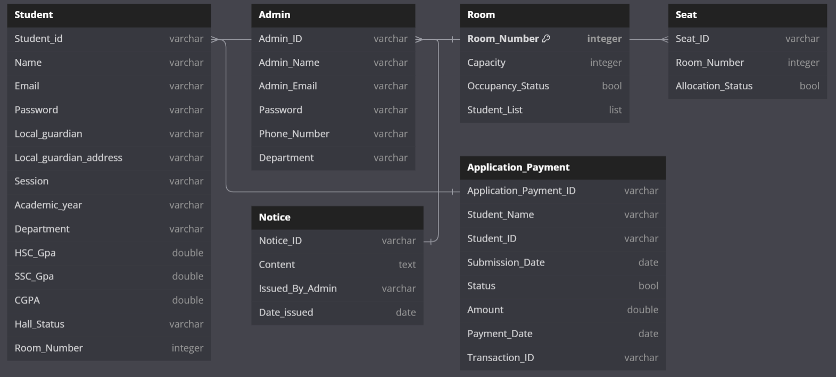
Class Diagram

Slide 11

Key Pages (Mockups/Designs)
  Student Registration Form
  Admin Dashboard
  Application Form
  Payment Portal
  Notice Board

Slide 12
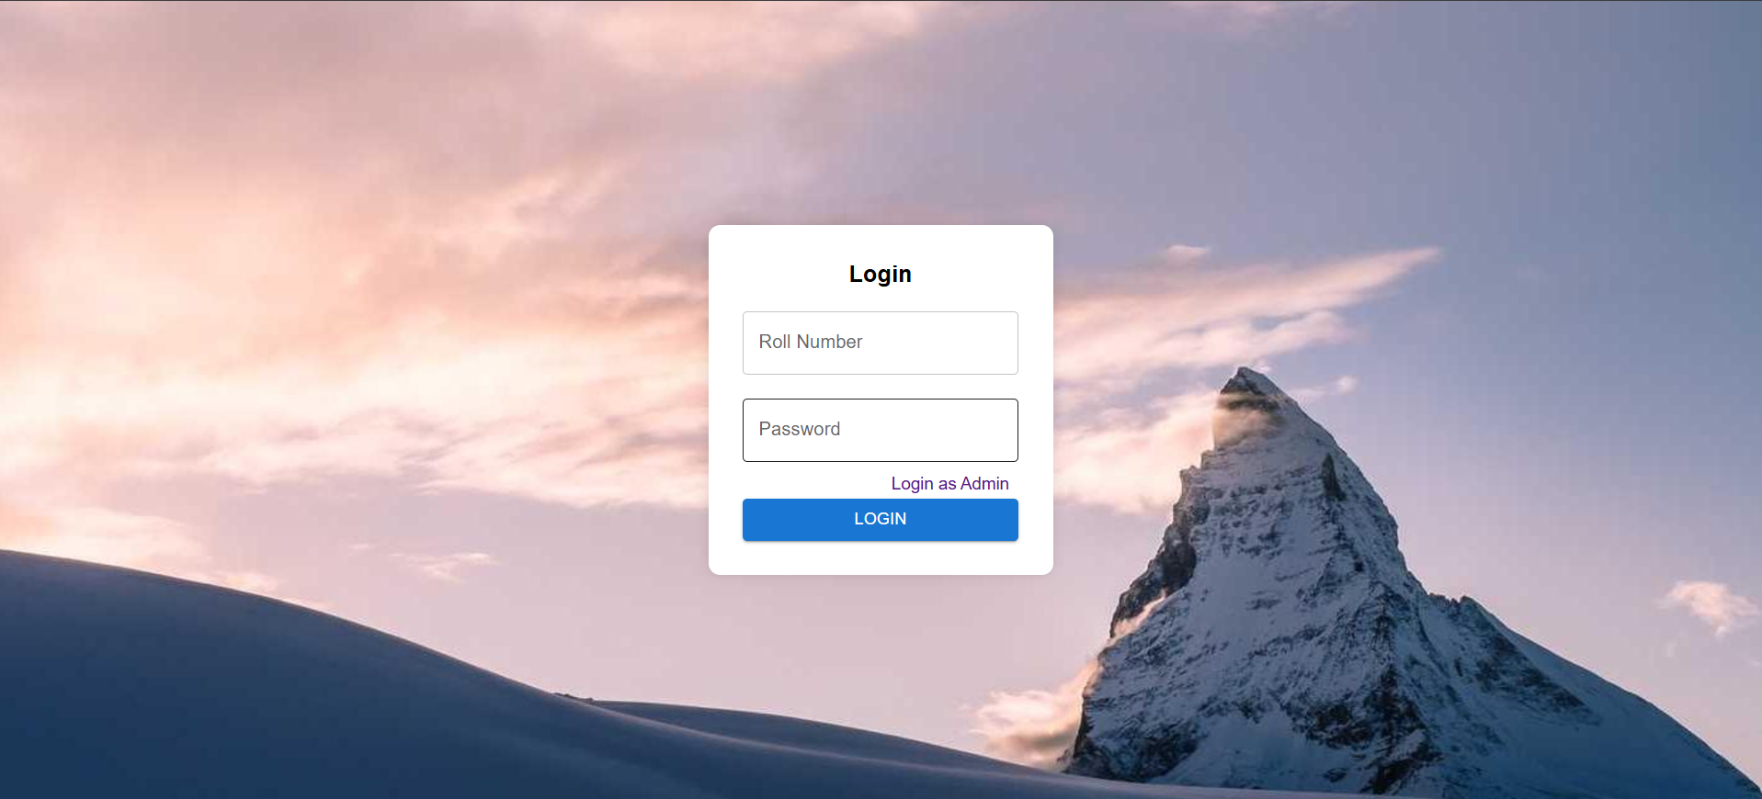
Authentication

Slide 13
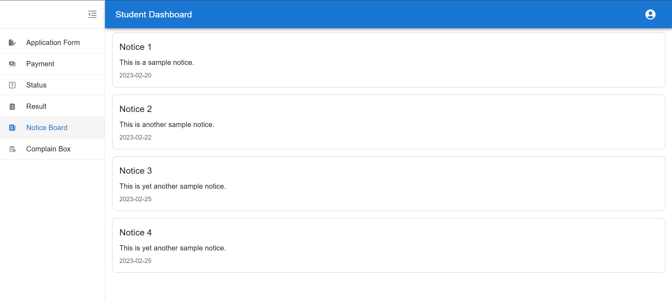
Notice Board

Slide 14
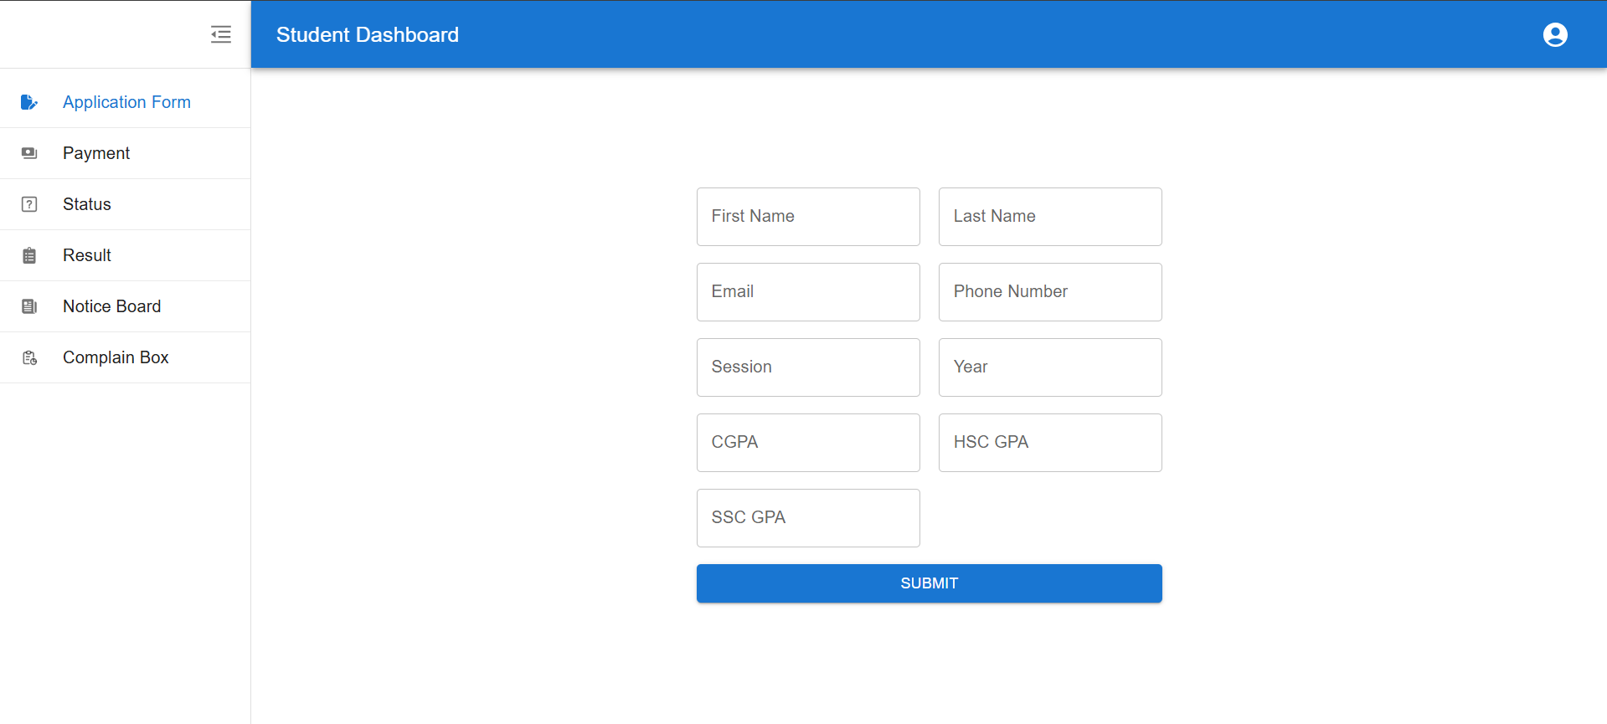
Form Fill up

Slide 15
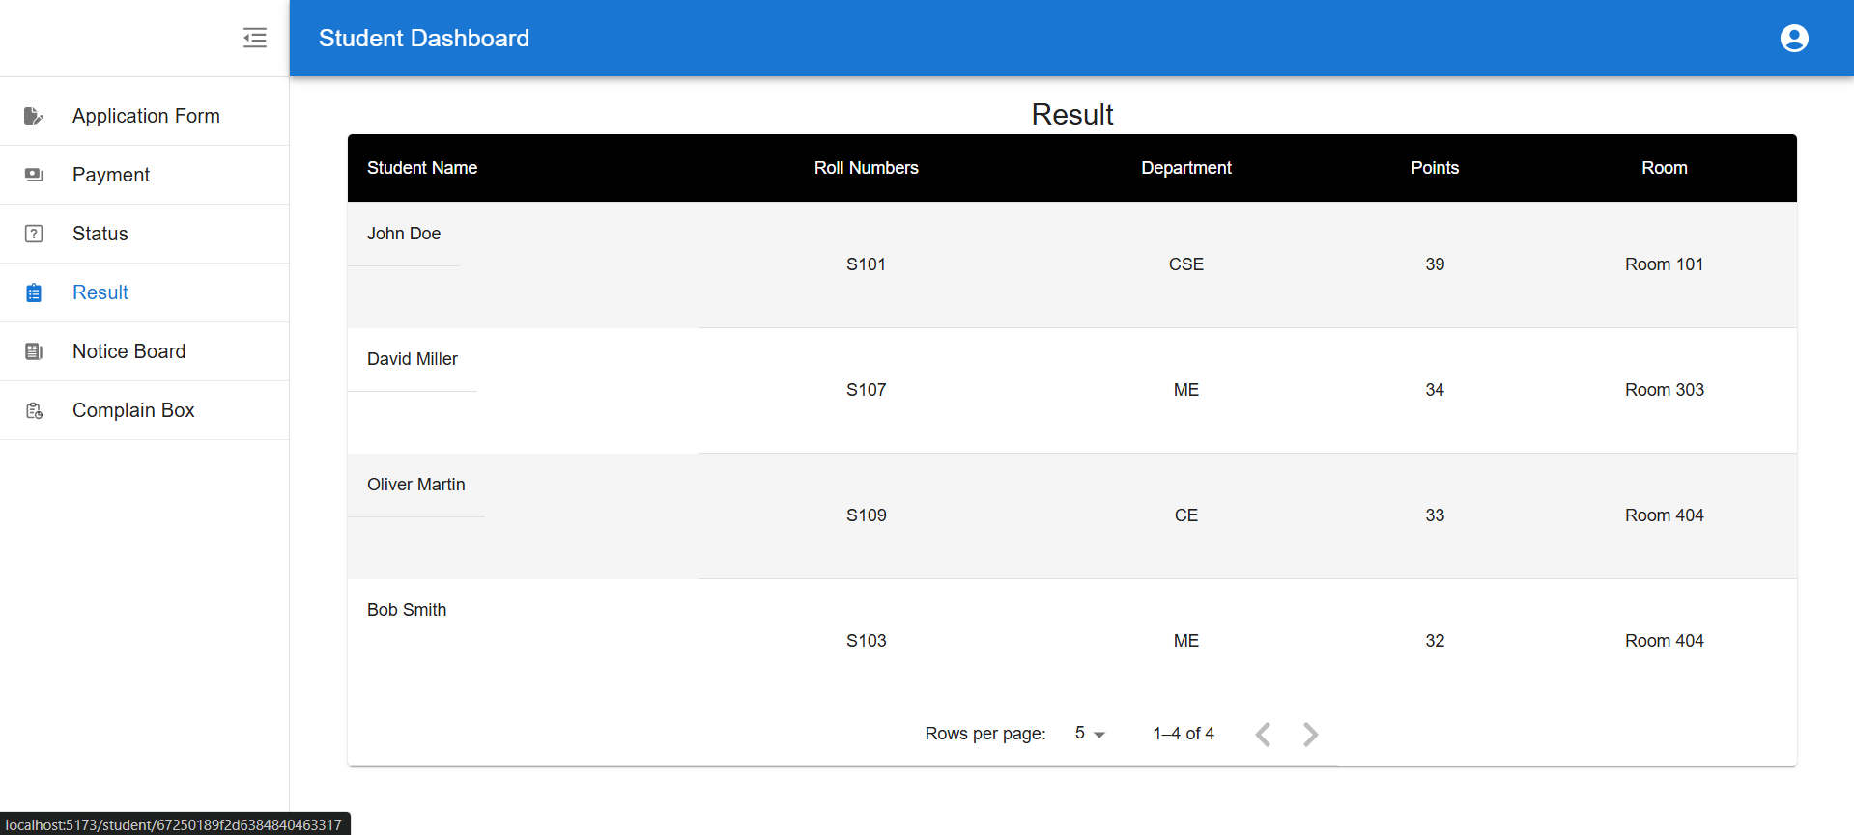
Allotment Result

Slide 16
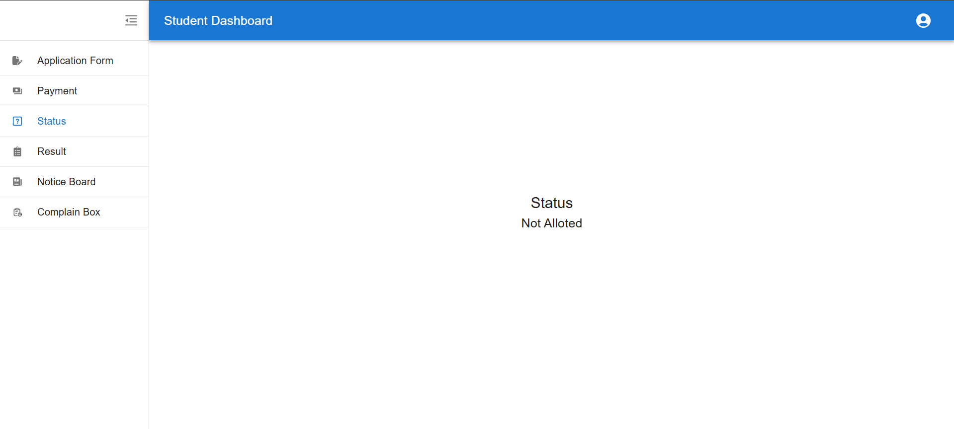
Student Status

Slide 17
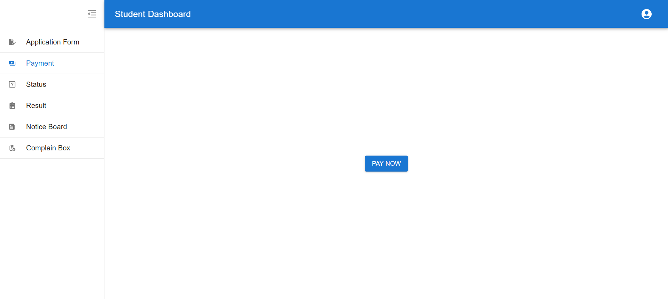
Payment

Slide 18
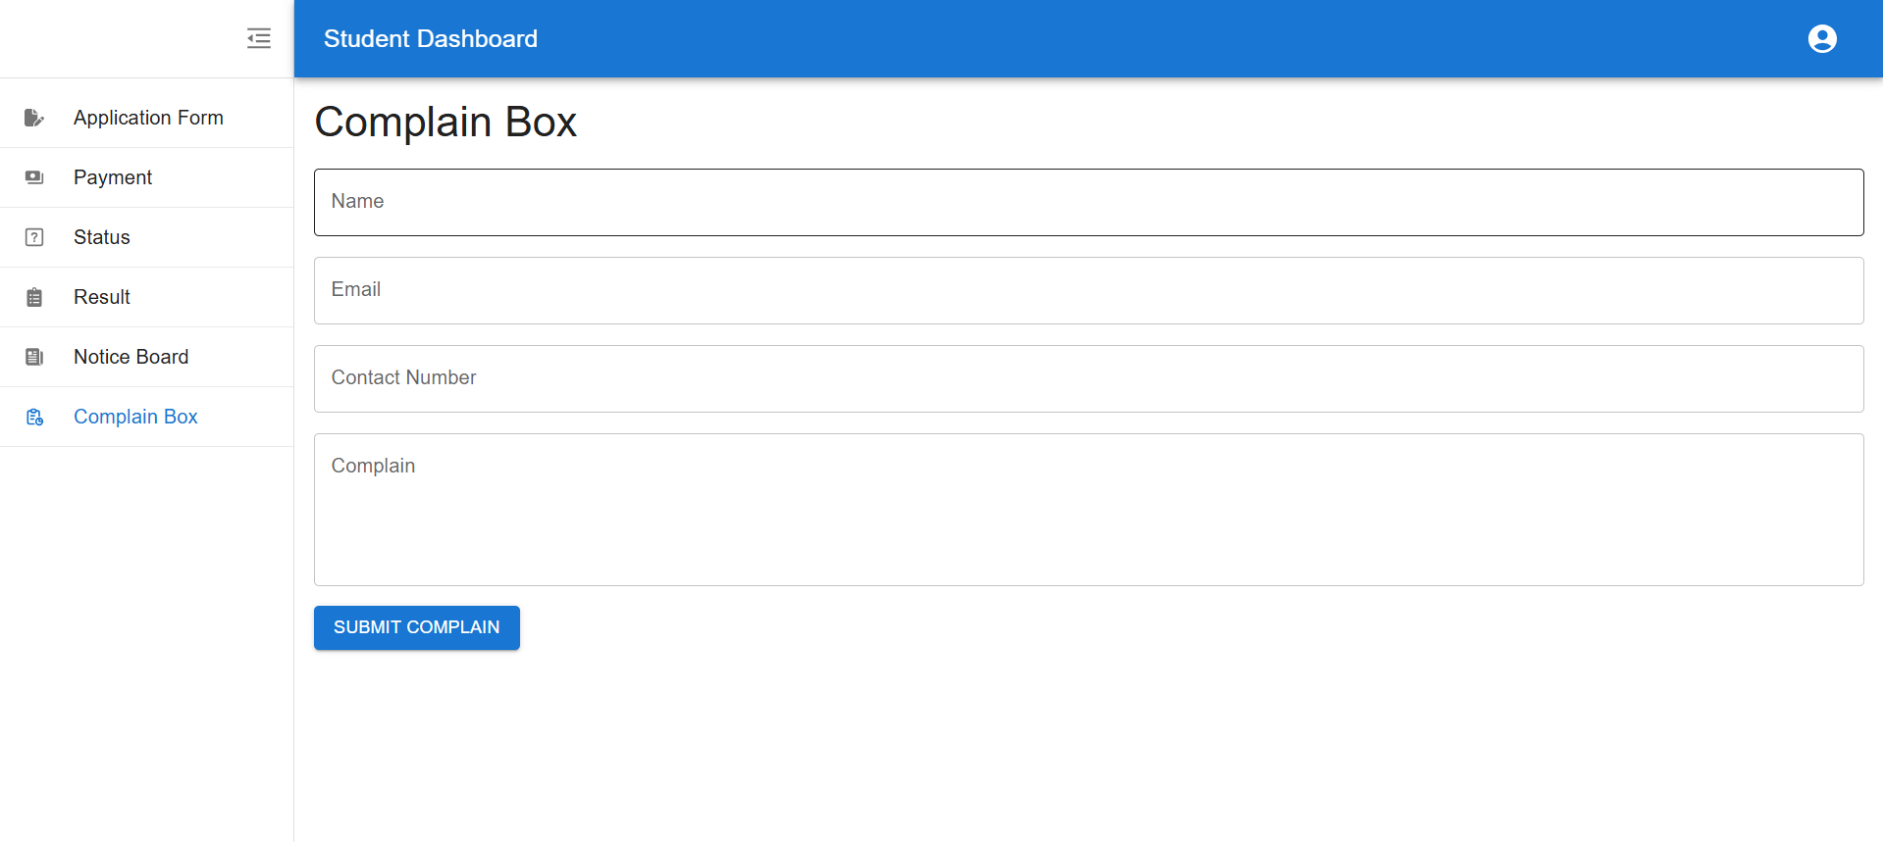
Complain Box

Slide 19
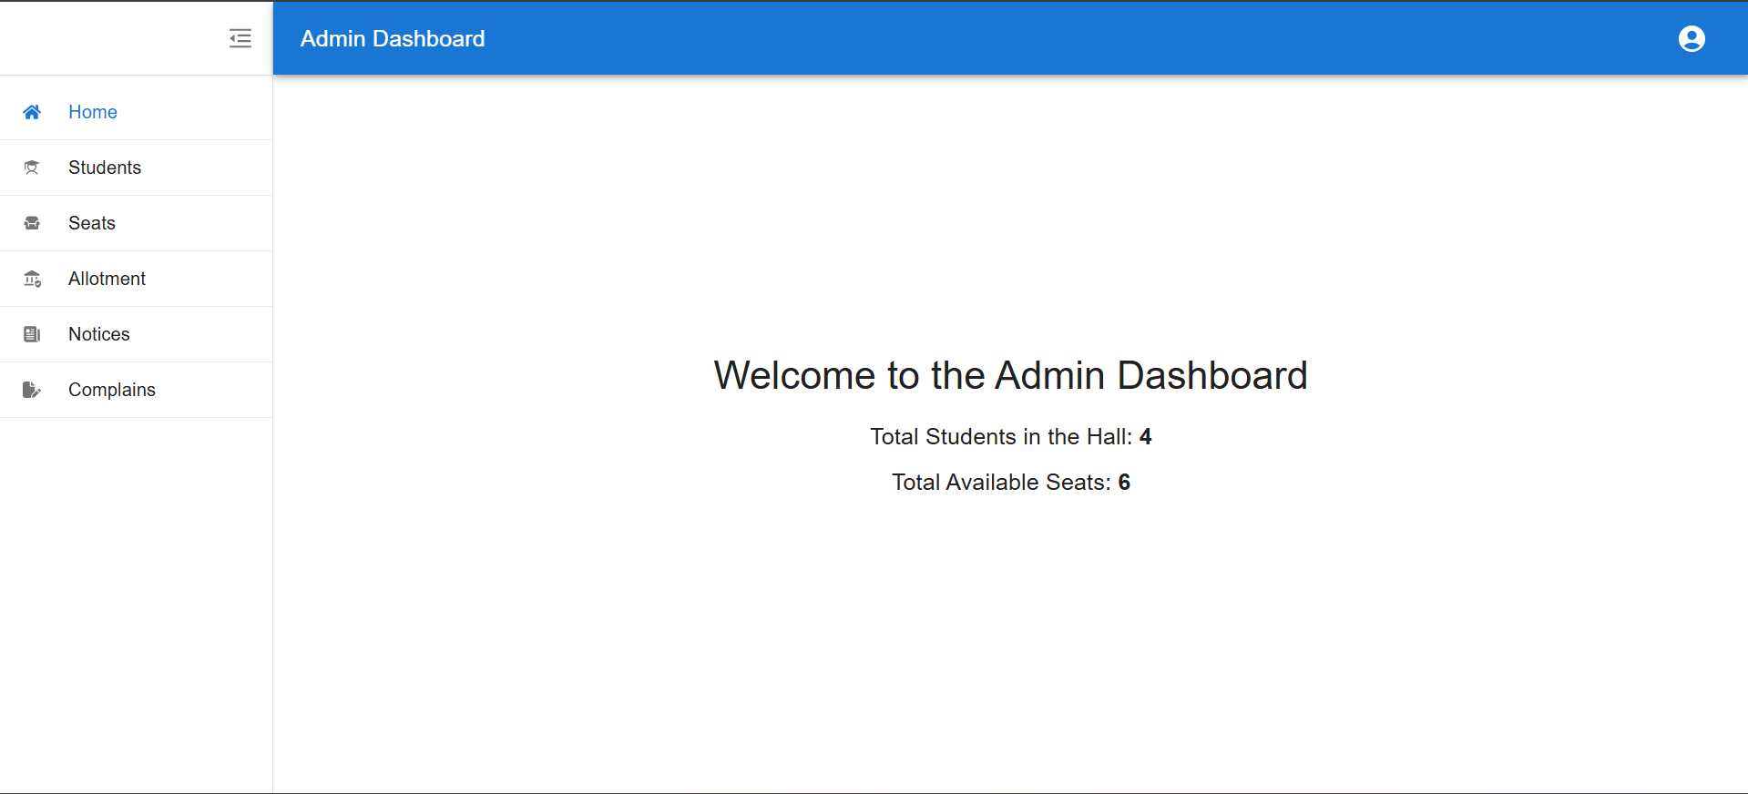
Admin Dashboard

Slide 20
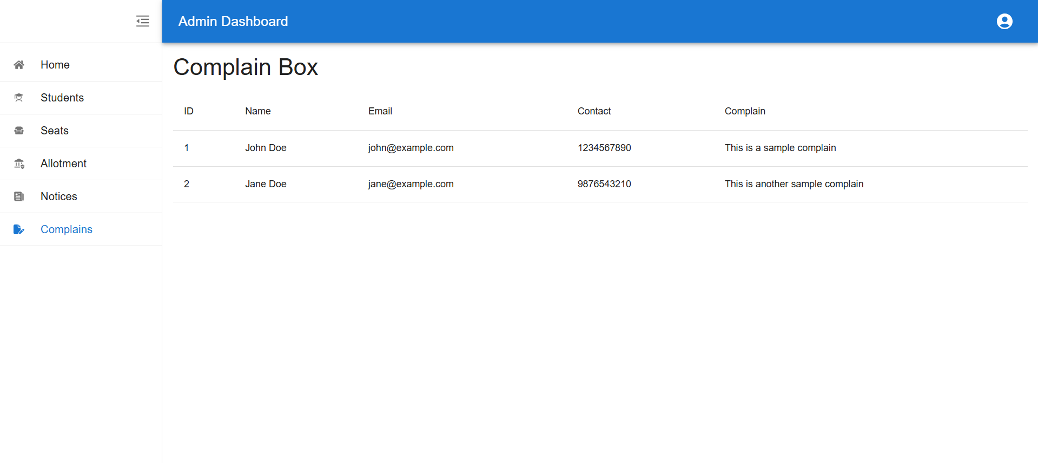
Complain Box View

Slide 21
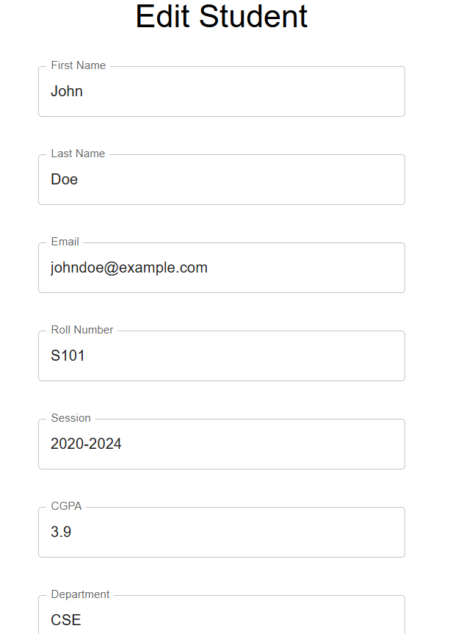
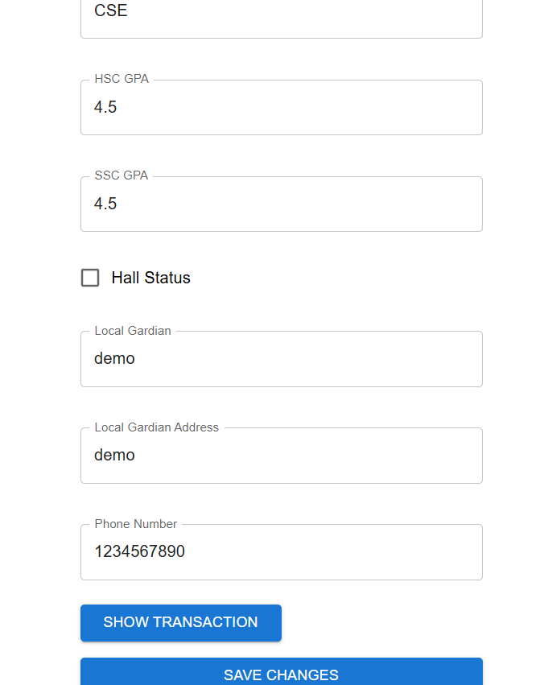
Edit Student

Slide 22
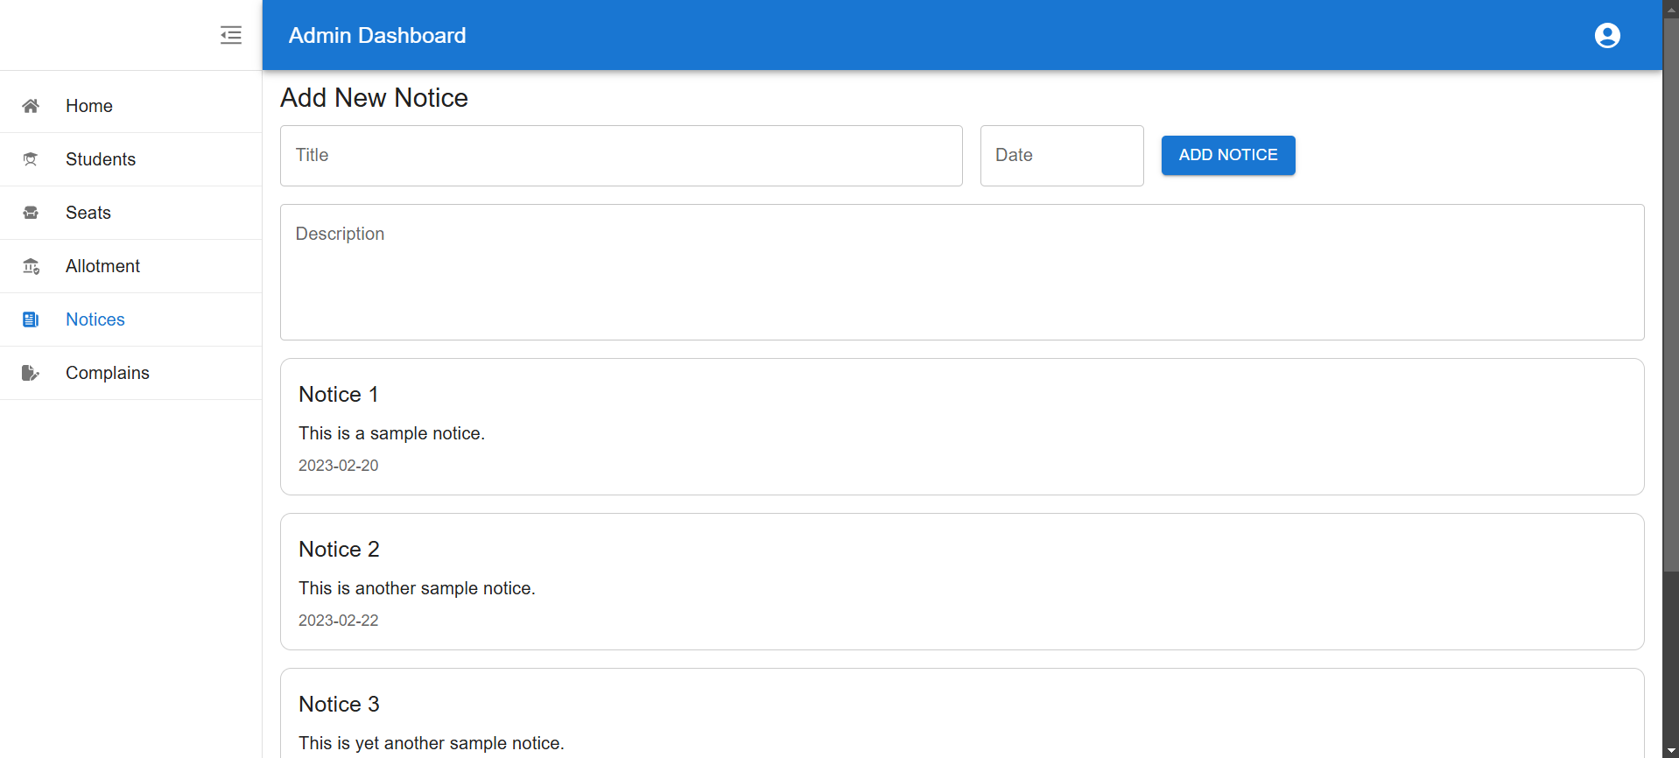
Notice Publish

Slide 23
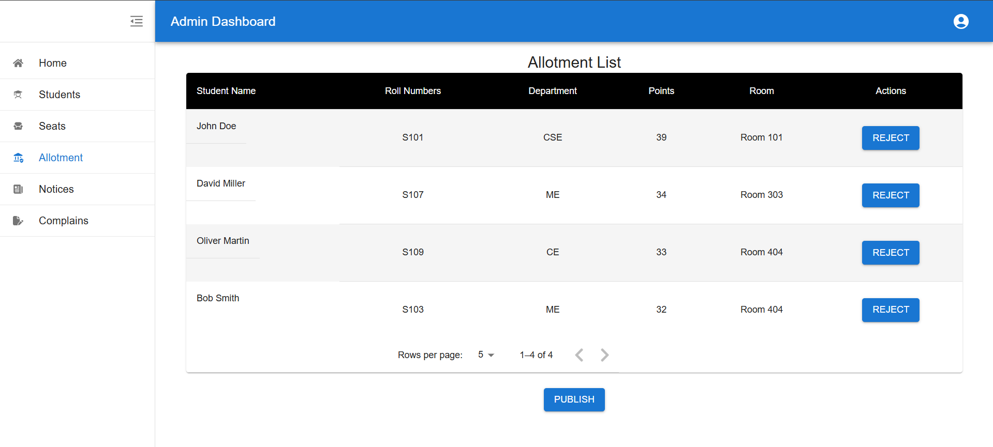
Allotment

Slide 24
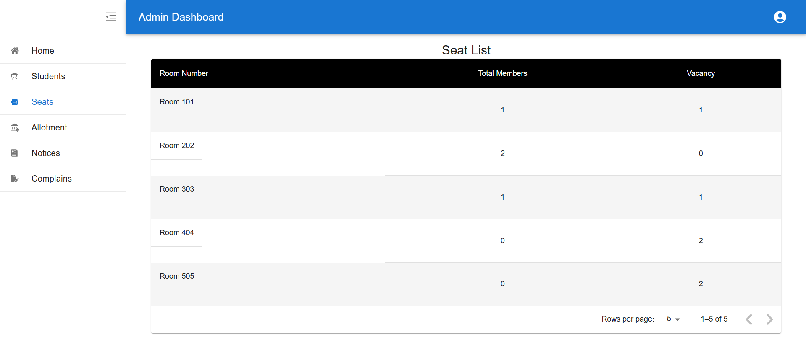
Seat Detail

Slide 25
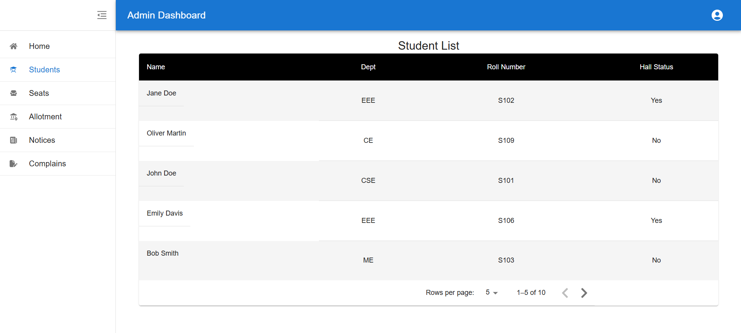
Student List

Slide 26

Overall Efficiency
Reduced workload to manpower
Scalable management system
Centralize control

Slide 27

Overall Benefits
Save time by 50%
Process reduced from days to minutes
Cost efficiency up to 50%
Sustainable solution

Slide 28
Conclusion
  The Hall Seat Management System is a comprehensive tool to manage hall allocations efficiently.
  It bridges the gap between students and administrators through automation.

Slide 29
Thank You
2110976127
2110276150
2110576158
2010676157

